Slide 1
XQTL analyses - 181026

Slide 2
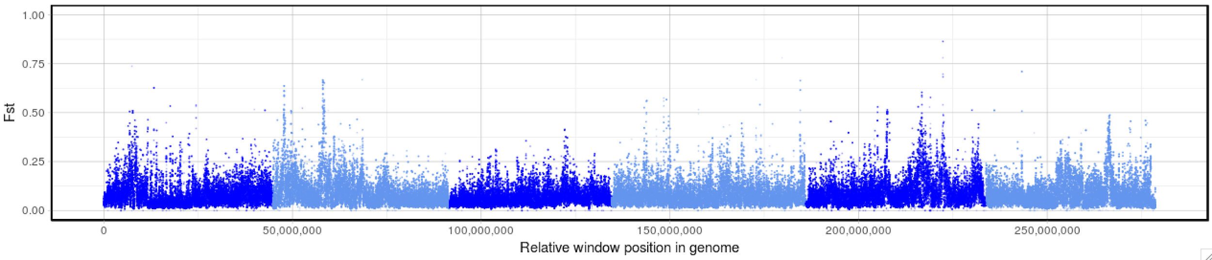
Parent: UGA vs ISE L3_200

Slide 3
PEAK_COORD (manually defined)
Halfway between peak max and genome-wide average Fst
([PEAK_FST + Genome-wide average Fst] /2 )
PEAK_FST
PEAK_START_FST
PEAK_END_FST
Fst
Genome-wide average Fst + 3SD
PEAK_START_COORD
PEAK_END_COORD
PEAK_WINDOW_SIZE
( PEAK_END_COORD - PEAK_START_COORD)

Slide 5
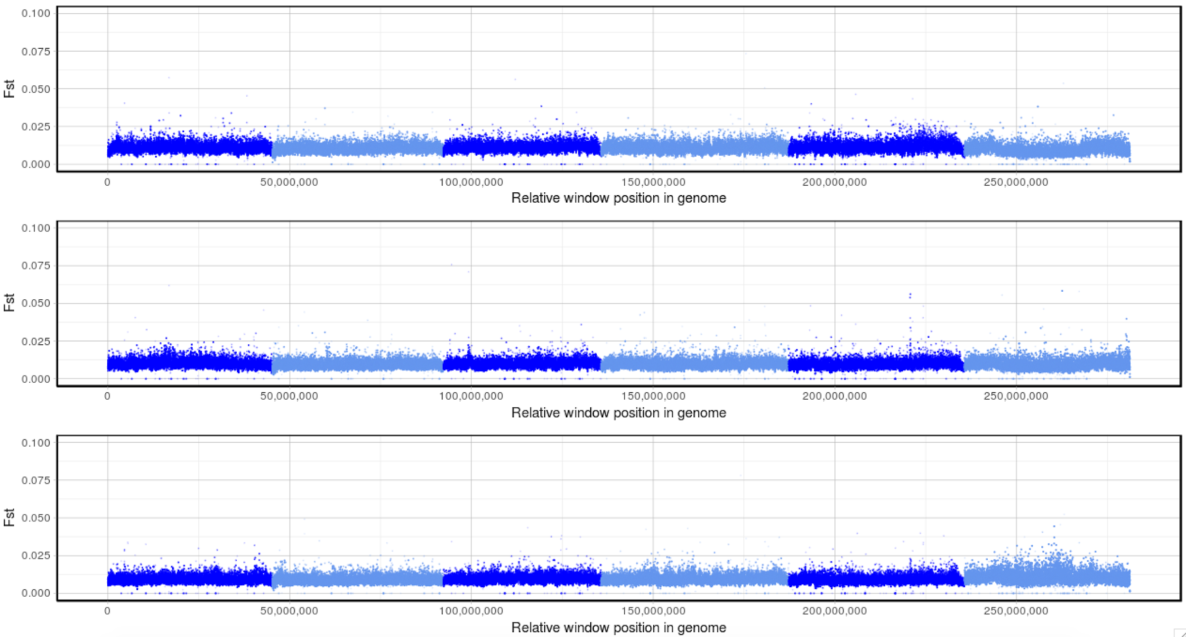
XQTL_control: F3 L3_n200
XQTL_control_R1
XQTL_control_R2
XQTL_control_R3

Slide 7
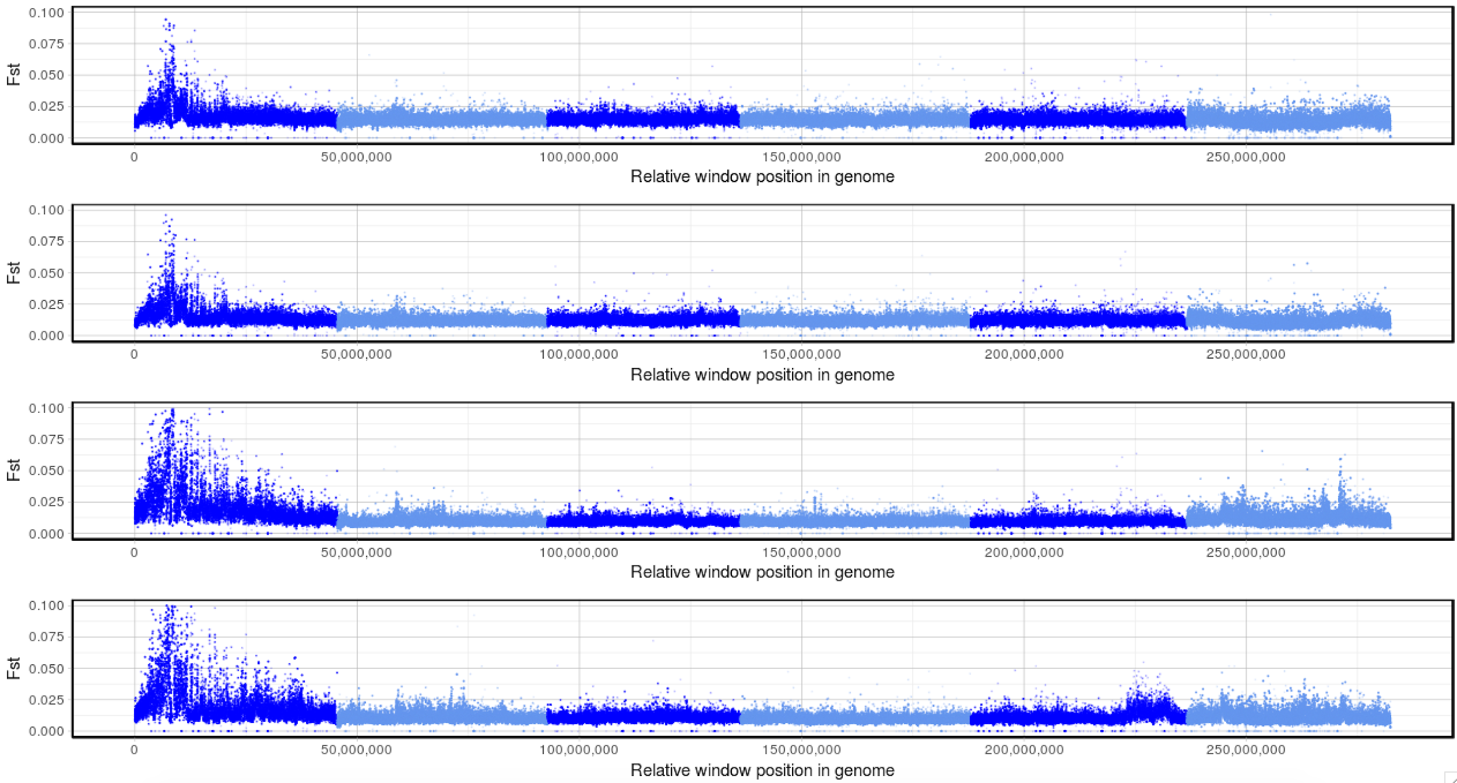
XQTL_BZ: F3 L3_n200
XQTL_BZ_R1.1
XQTL_BZ_R1.2
XQTL_BZ_R2
XQTL_BZ_R3

Slide 9
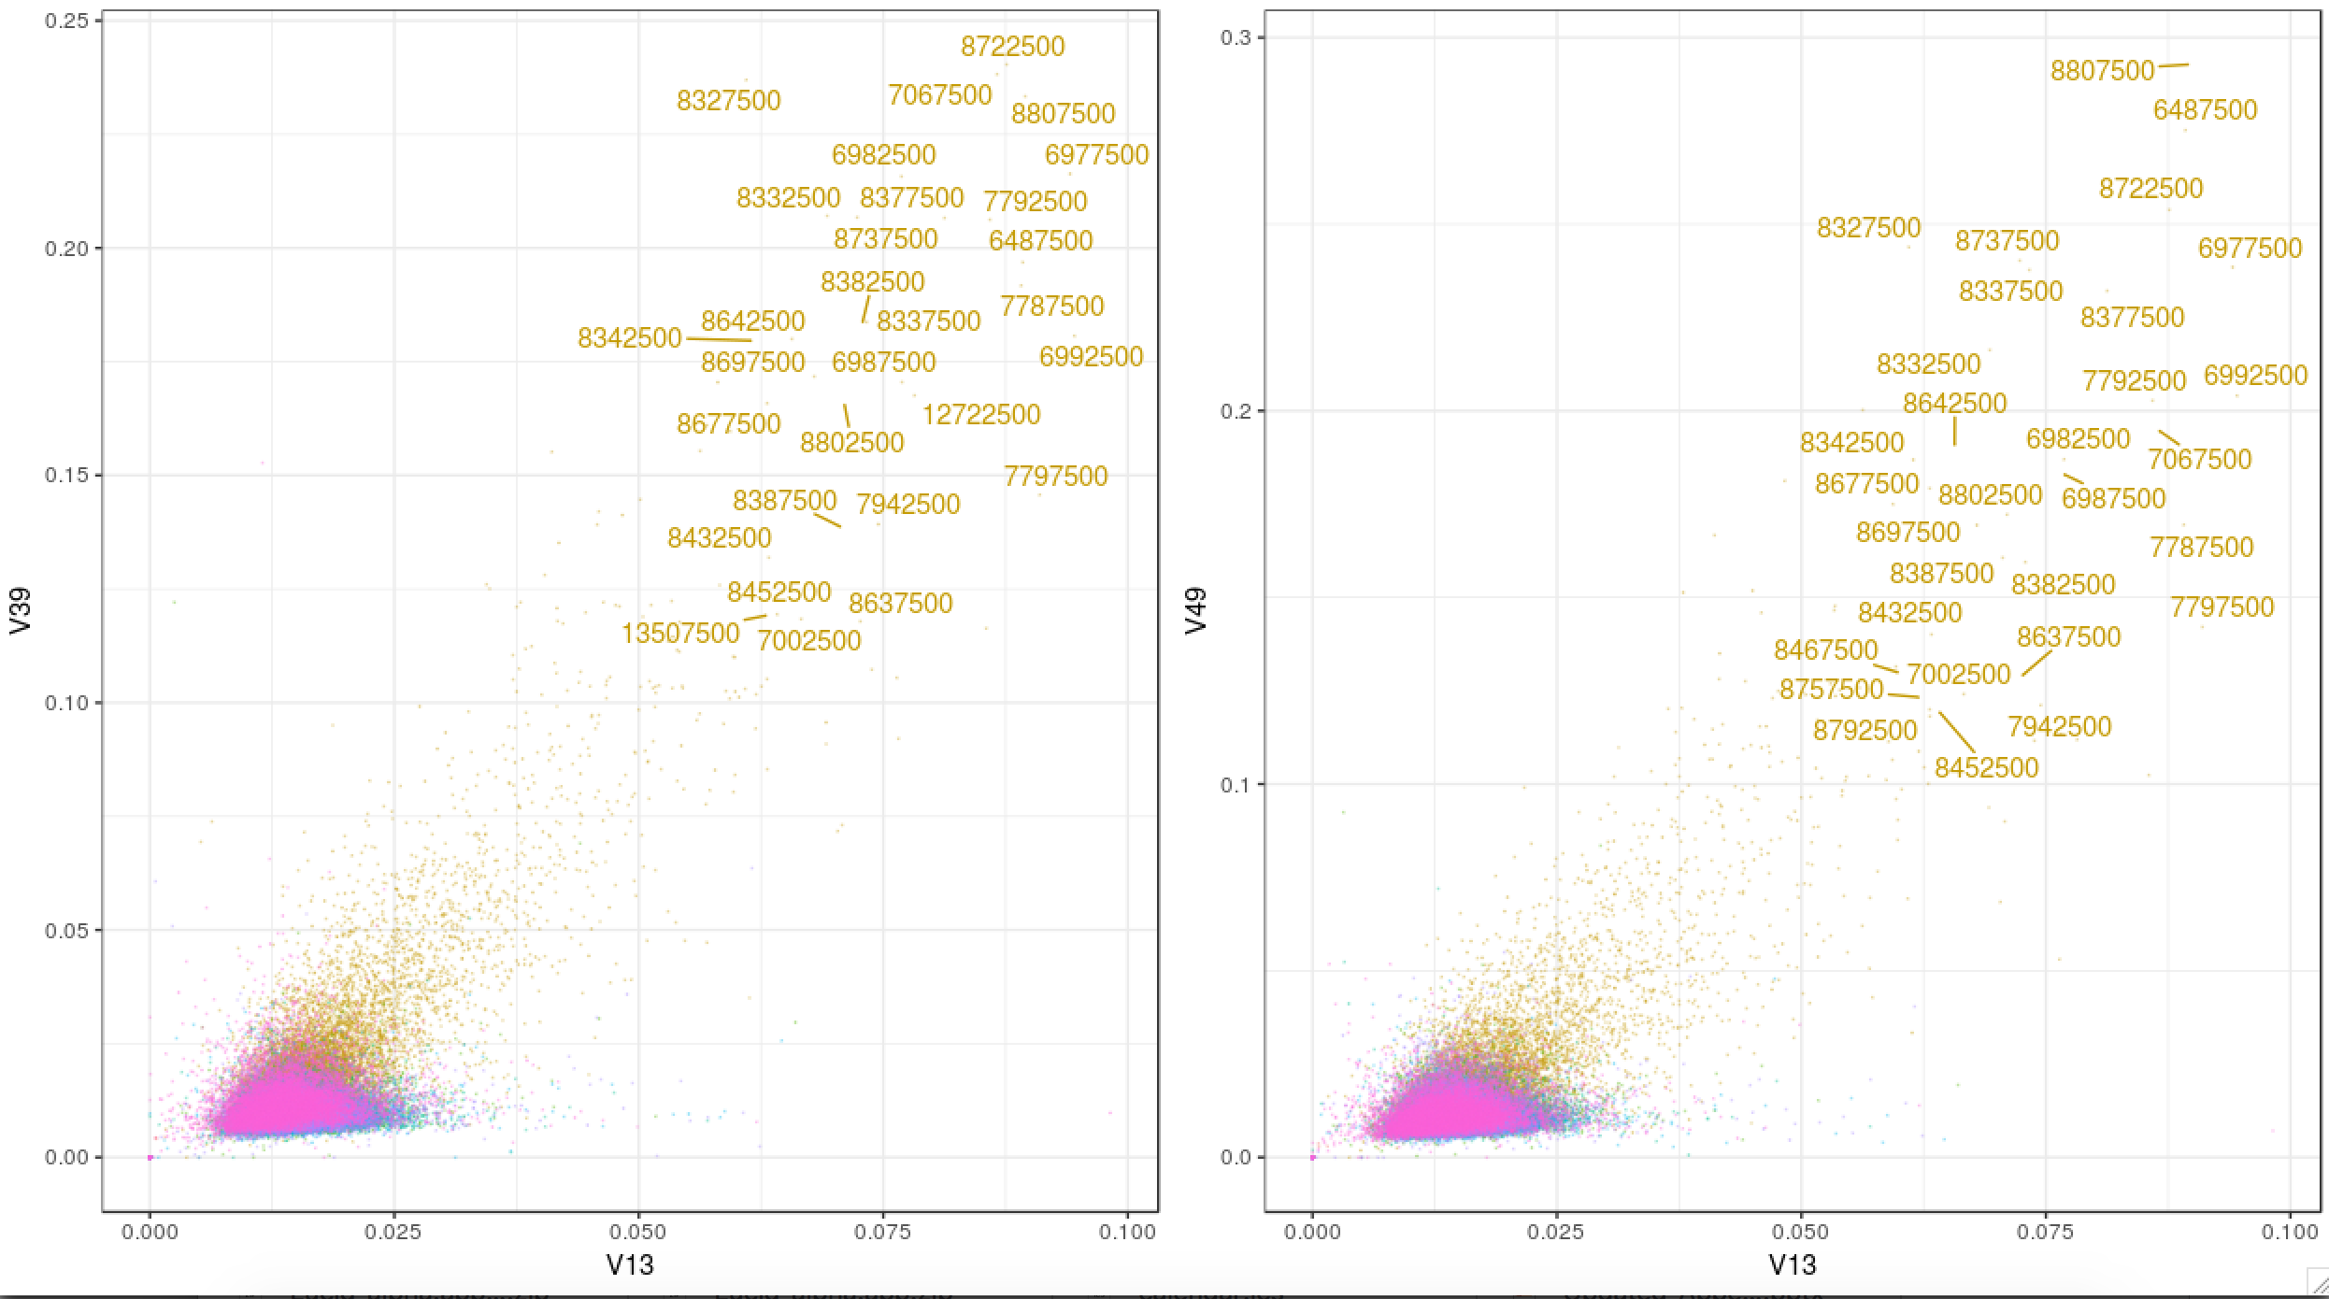
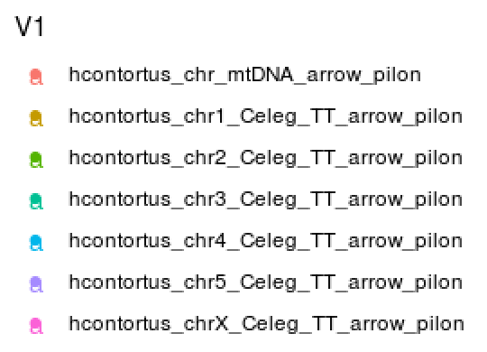
XQTL_BZ: F3 L3_n200 – pairwise between replicates
hcontortus_chr1_Celeg_TT_arrow_pilon:7027492-7031447
#Rep1.1 Rep1.2 Rep2 Rep3
#V13 V27 V39 V49

Slide 10
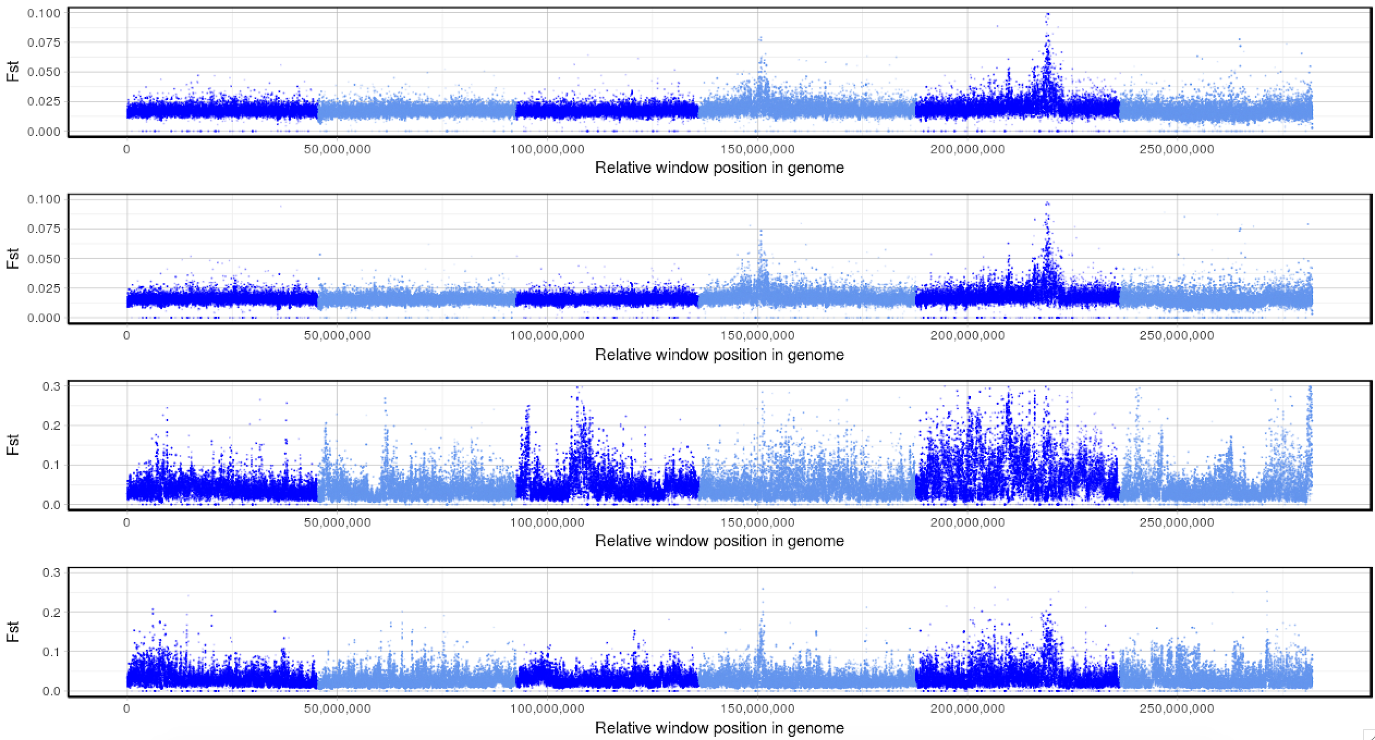
XQTL_LEV: F3 L3_n200
XQTL_LEV_R1.1
XQTL_LEV_R1.2
XQTL_LEV_R2
XQTL_LEV_R3
Note: Fst scale of bottom two plots is different

Slide 12
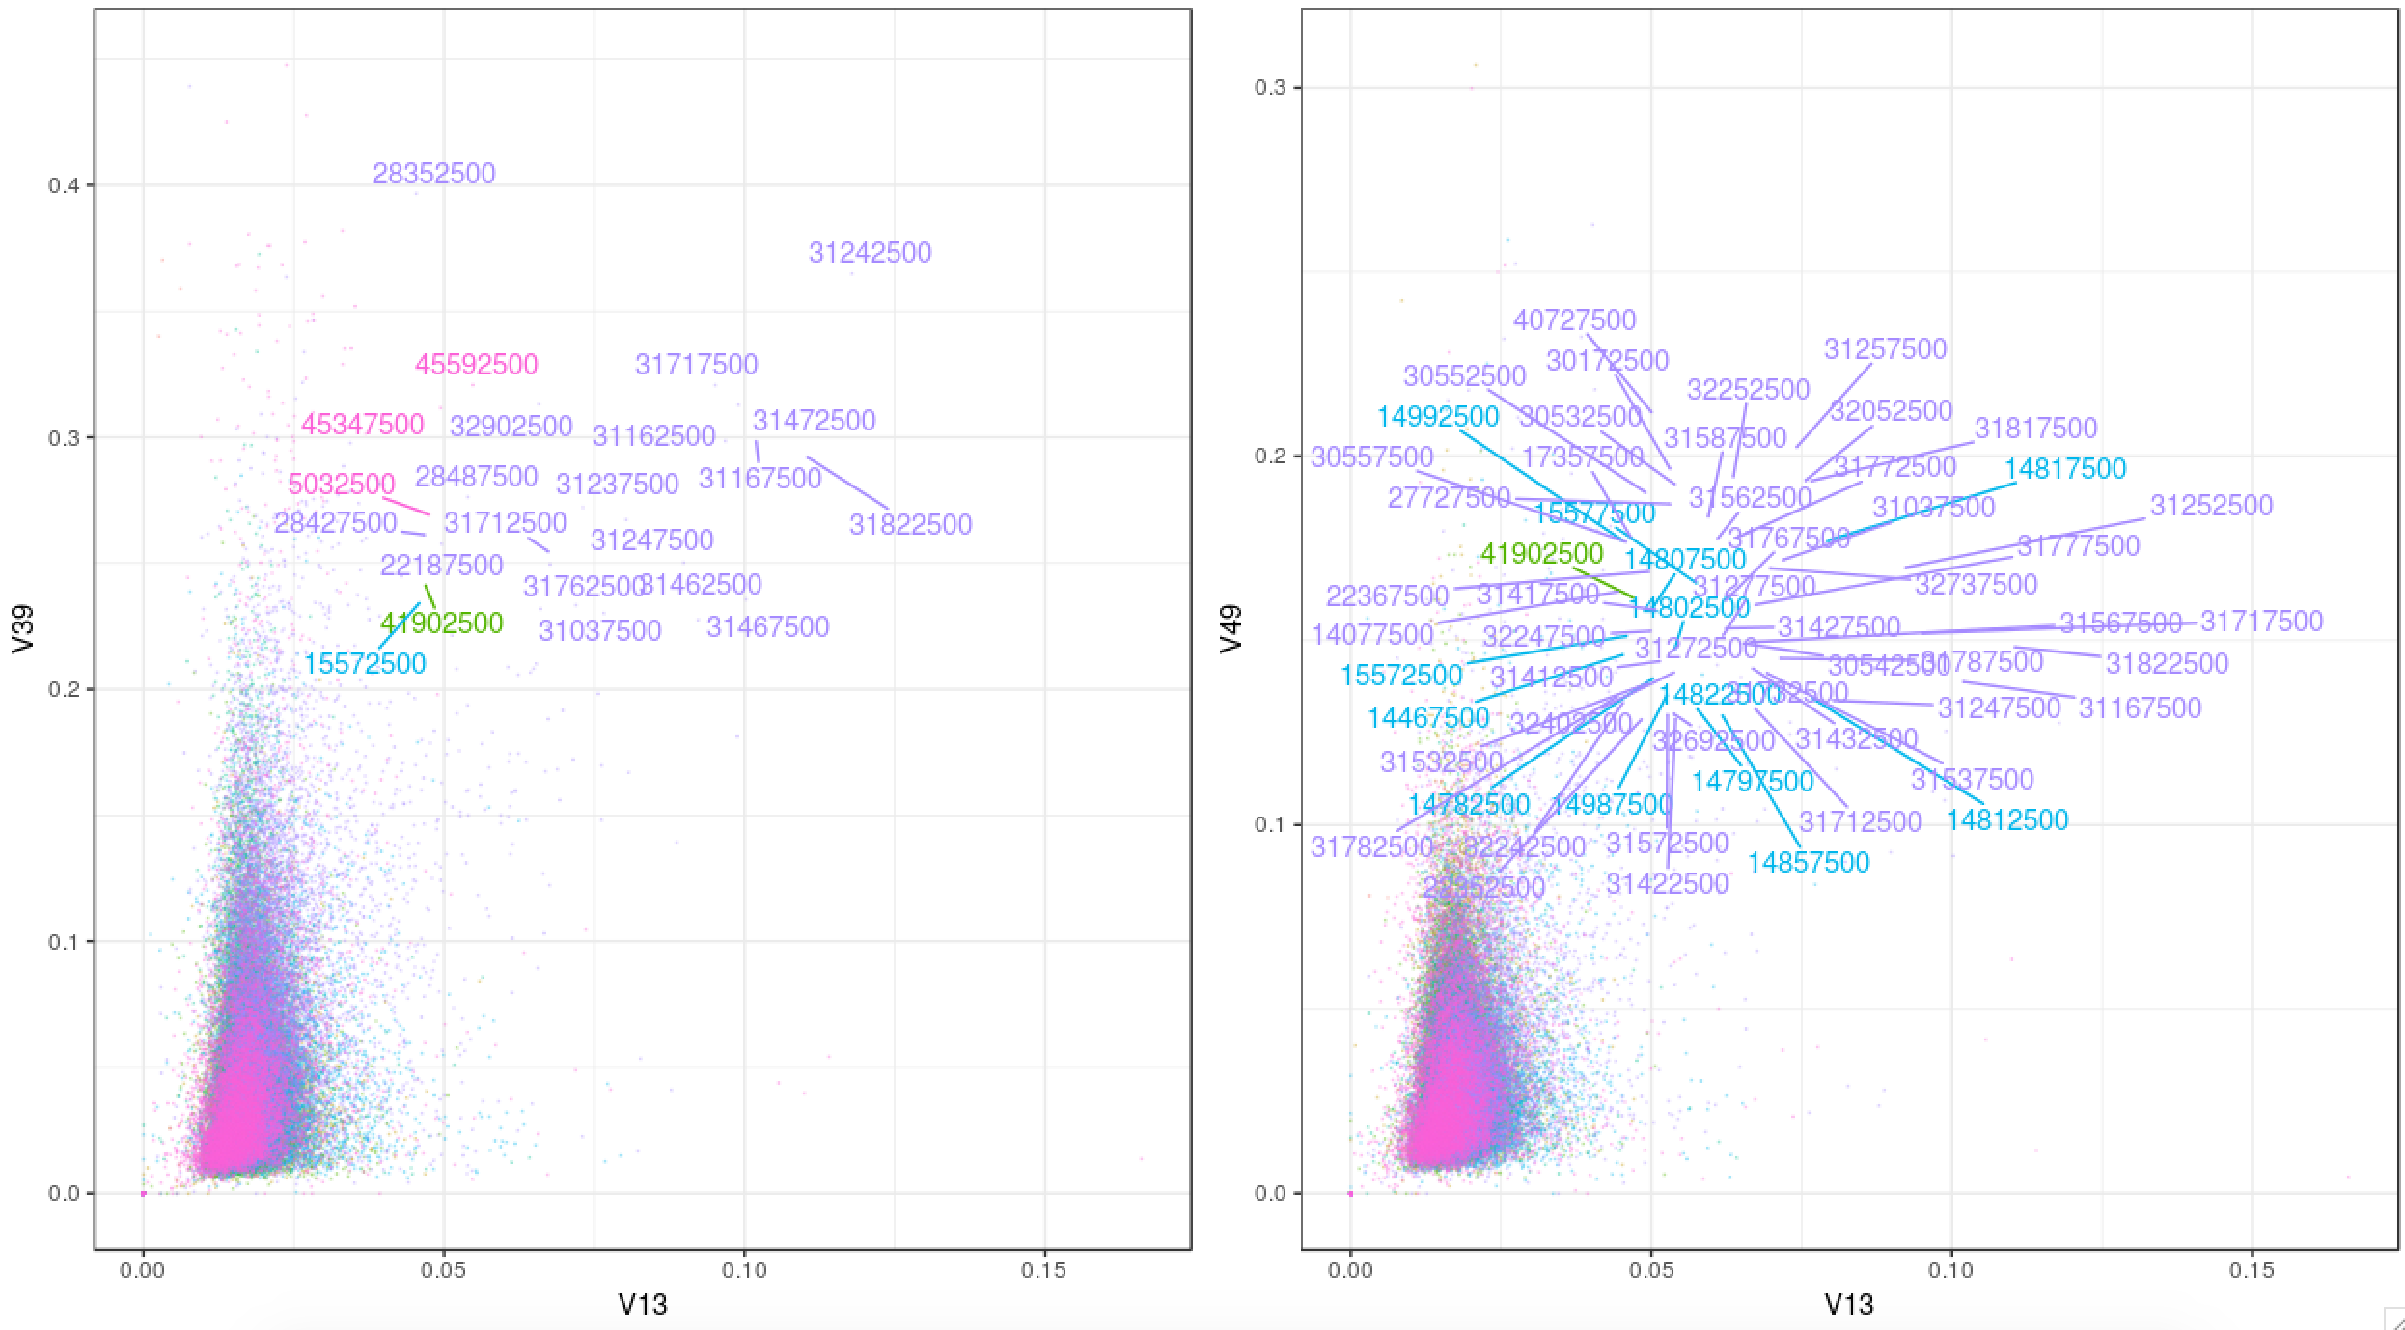
XQTL_LEV: F3 L3_n200 – pairwise between replicates
#Rep1.1 Rep1.2 Rep2 Rep3
#V13 V27 V39 V49

Slide 13
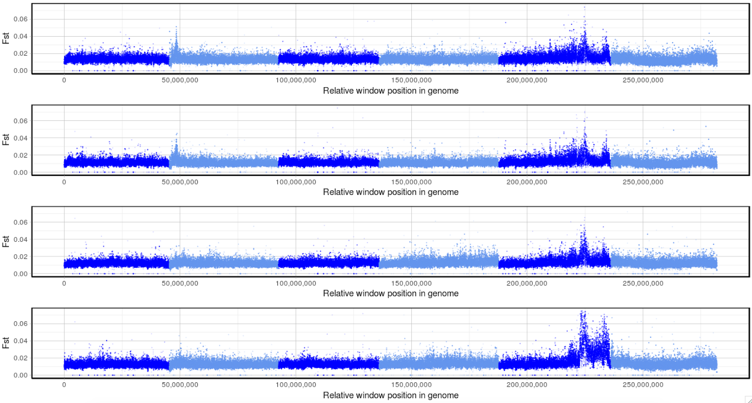
XQTL_IVM: F3 L3_n200
XQTL_IVM_R1.1
XQTL_IVM_R1.2
XQTL_IVM_R2
XQTL_IVM_R3

Slide 15
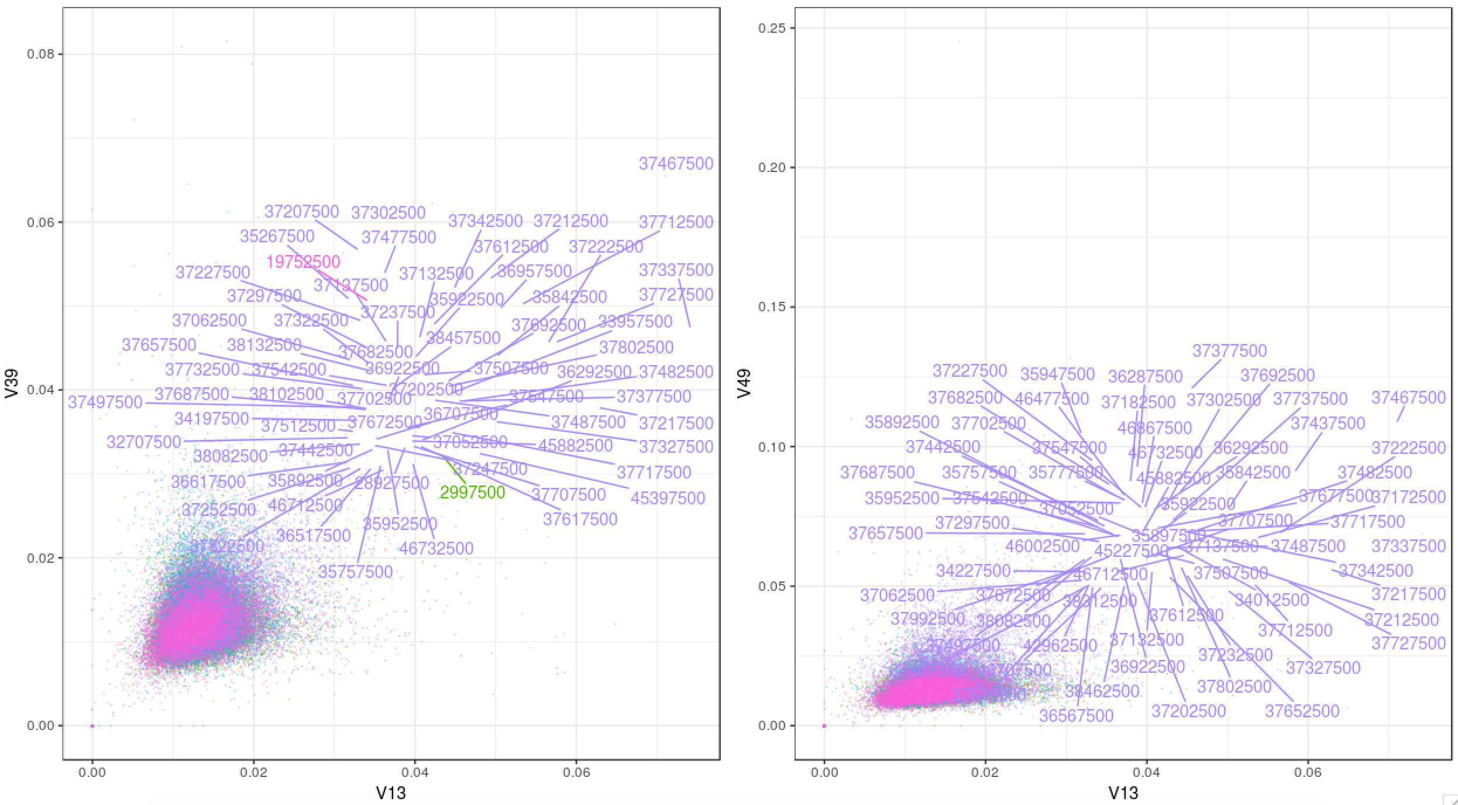
XQTL_IVM: F3 L3_n200 – pairwise between replicates

Slide 16
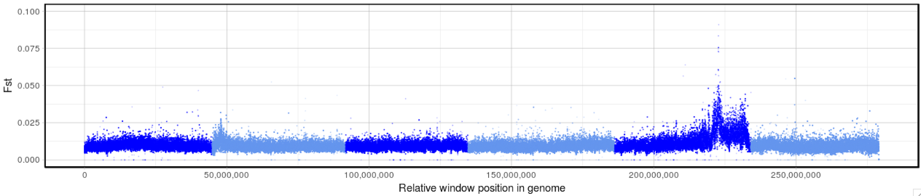
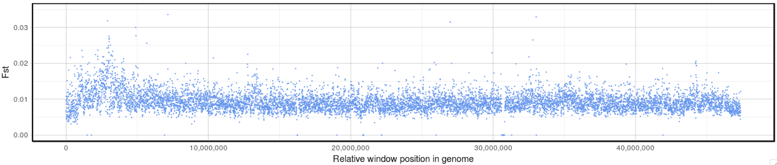
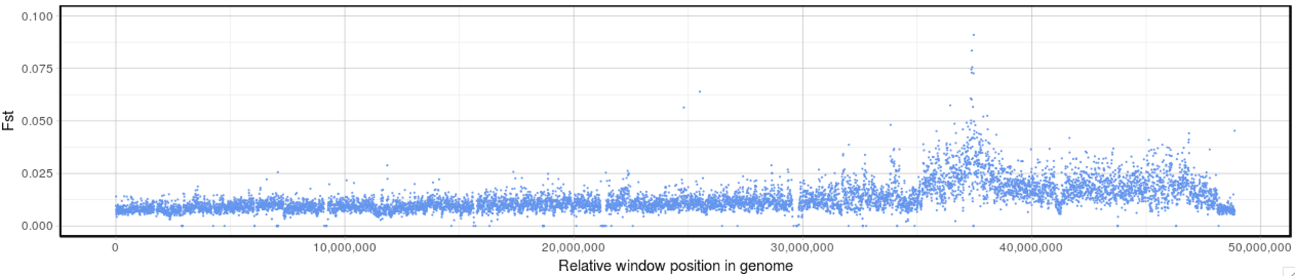
XQTL_IVM: F3 L3_n5000
Chr II
Chr V
Note: Fst scale of top plot is 1/10th of parents

Slide 18
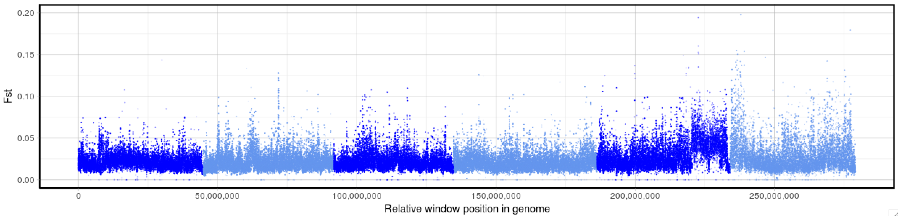
XQTL_IVM: F2 AdultM_n40
AdultM
L3_5000
Note: Fst scale of adults is double of L3

Slide 20
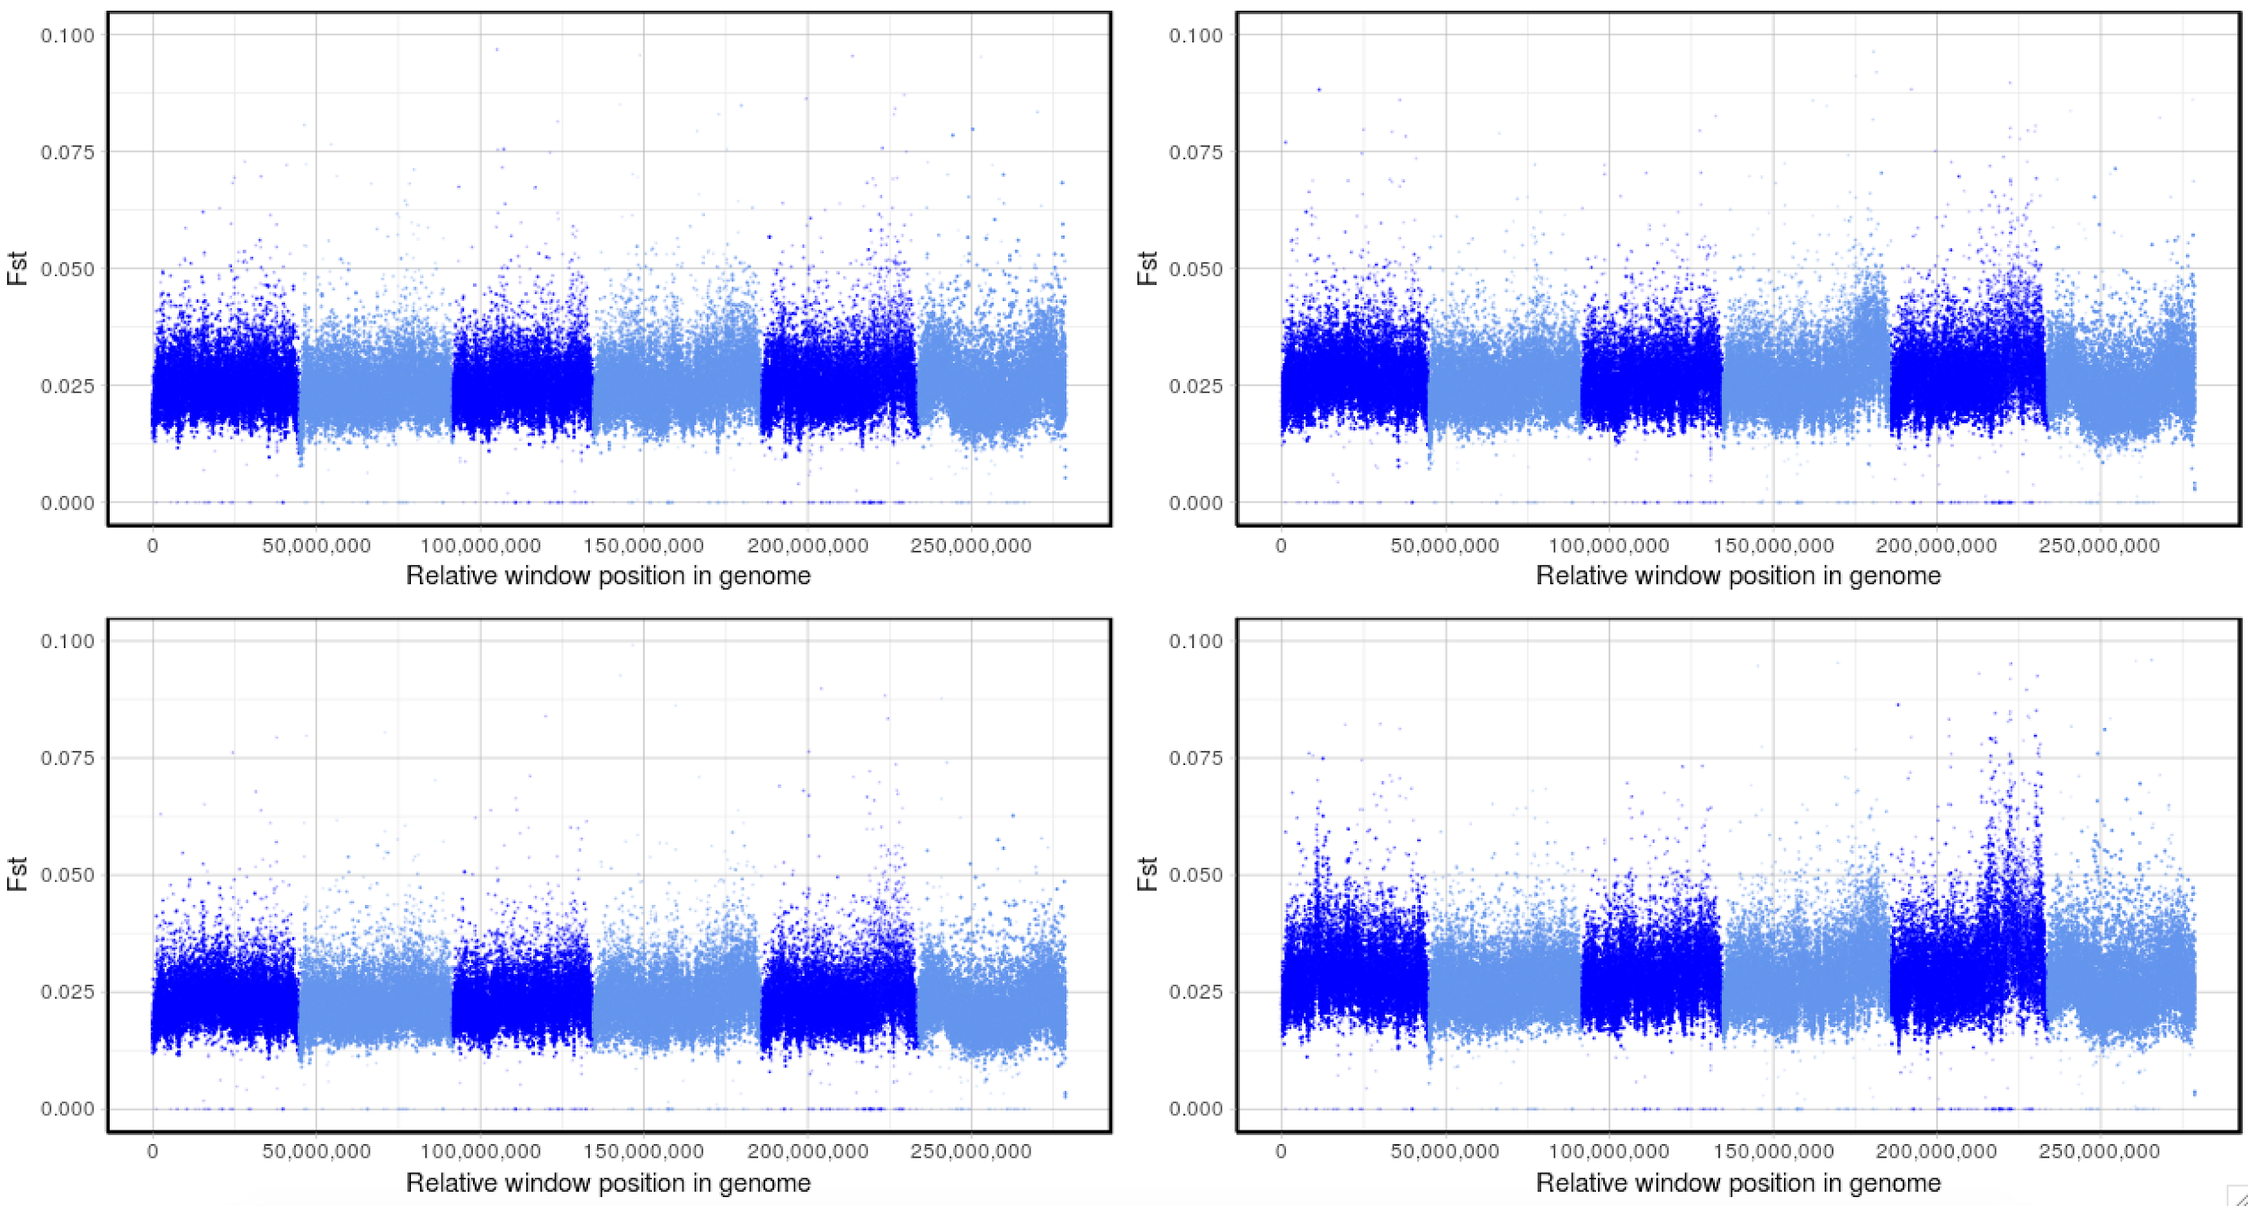
XQTL_AdvancedIntercross: F4 L3_n200 - replicate 1
Control_pre_v_0.5X
IVM_pre_v_0.5X
Control_pre_v_2X
IVM_pre_v_2X

Slide 21
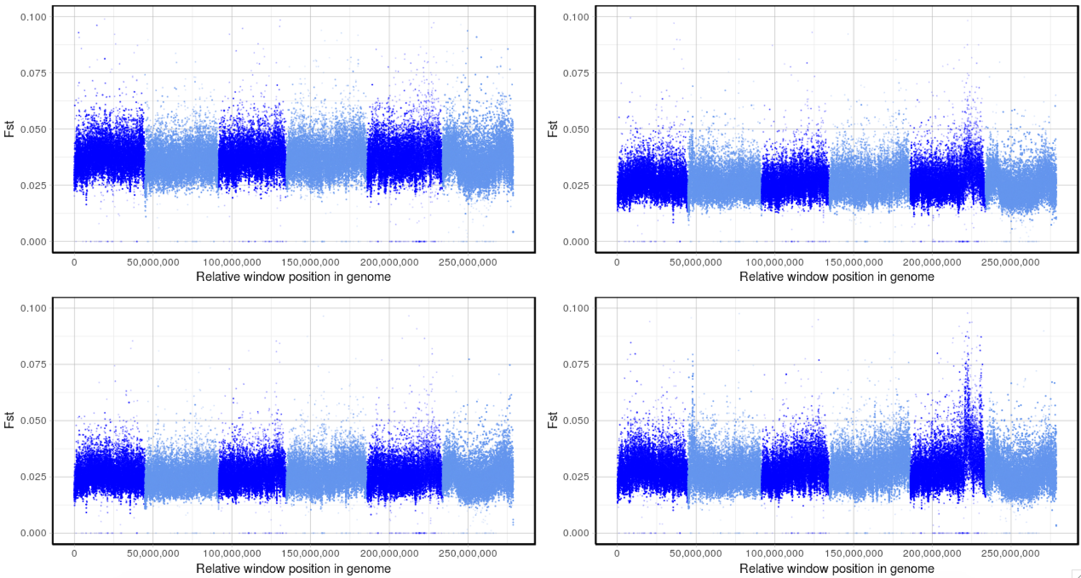
XQTL_AdvancedIntercross: F4 L3_n200 - replicate 2
Control_pre_v_0.5X
IVM_pre_v_0.5X
Control_pre_v_2X
IVM_pre_v_2X

Slide 22
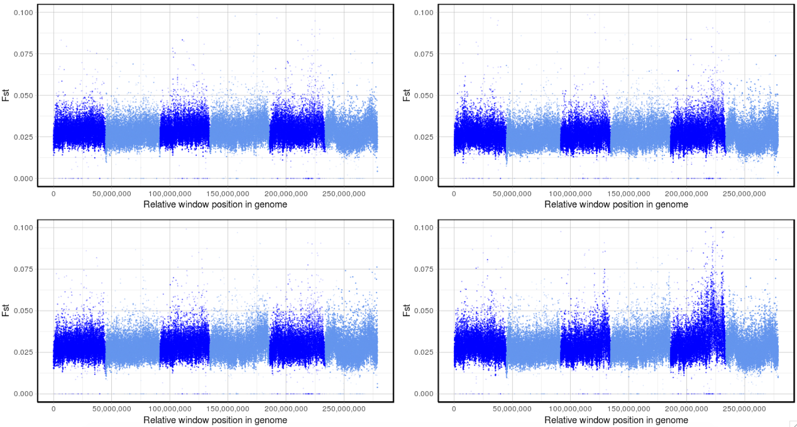
XQTL_AdvancedIntercross: F4 L3_n200 - replicate 3
Control_pre_v_0.5X
IVM_pre_v_0.5X
Control_pre_v_2X
IVM_pre_v_2X

Slide 23
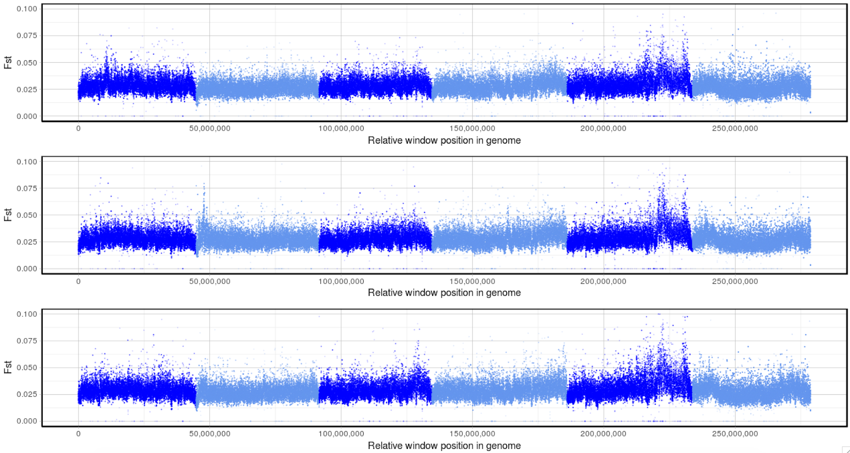
XQTL.R1
AI.R1
AI.R2
AI.R3

Slide 25
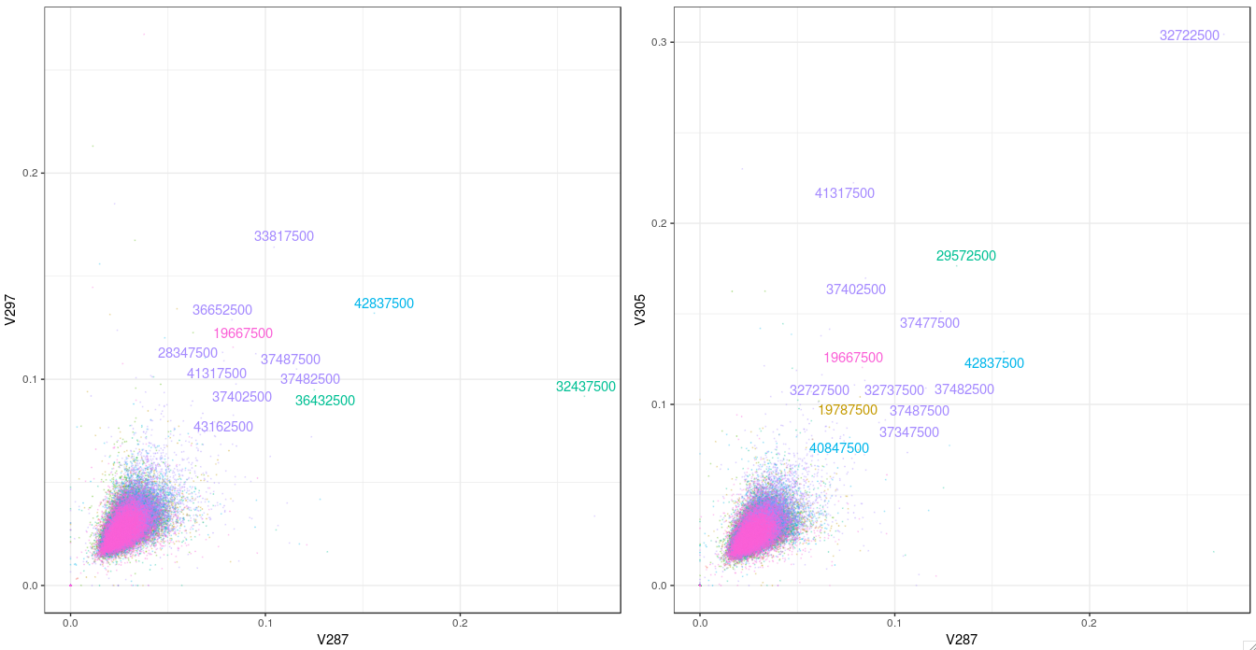
XQTL_AIntercross: F4 L3_n200 – pairwise between pre v IVM2x replicates

